Slide 1
Getting a grip on recursion
“To understand recursion, one must first understand recursion”
Terence Parr
MSDS program University of San Francisco

Slide 2
Recursion is just delegation
Consider an org chart
Bosses delegate to subordinates
CEO wants work done:
sends emails to 2 VPs
who launch 2 other workers
those workers launch emails too
until potentially all n contacted
Max work is n workers times work each worker performs
Trace from CEO to mailroom cost is just height of org chart: log(n) in typical case
Example: phone tree where each person calls k other people
Jeff

Slide 3
Recursion is more like startup org chart
One person has to play every role, cloning themselves
Person “pauses” current work, performs subtask(s), then continues where they left off, possibly using subtask results
Each call or email to worker is analogous to a function call
“Recursive leap of faith”
(A large company could launch multiple core/employees)

Slide 4
Let’s start with math recurrence relations
Factorial definition:
Let 0! = 1
Define n! = n * (n-1)! for n>=1
Recurrent math function calls become recursive function call in Python
Non-recursive version is harder to understand and less natural
This has linear time O(n); T(n) = k + T(n-1) = kn; more clear in non-recursive version
def fact(n):
if n==0: return 1
return n * fact(n-1)
def factloop(n):
r = 1
for i in range(1,n+1):
r *= i
return r

Slide 5
Fibonacci sequence
def fib(n):
if n==0 or n==1: return 1
return fib(n-1) + fib(n-2)
Let F(0) = F(1) = 1
Define F(n) = F(n-1) + F(n-2) for n>=2
Recursive implementation is very natural but mucho inefficient!
We do small bit of work to combine results of two subproblems, and each subproblem is only 1 and 2 elements smaller
Compare this to fact(n) where we do small bit of work using result of a single subproblem, which has linear time

Slide 6
Compare fact, fib call trees visually
Difference comes down to two versus one subproblem!
Key idea: recursion traces out a tree of function calls (implies recursion is most natural way to walk trees)

Slide 7
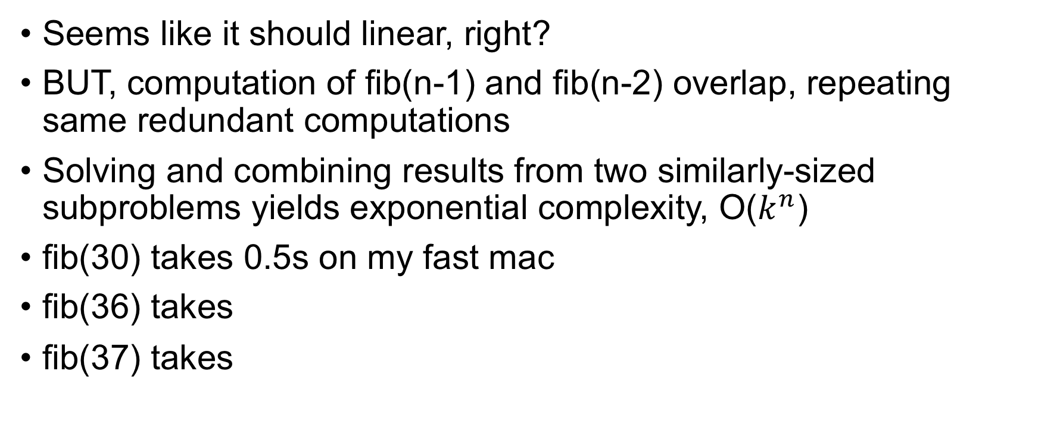
How fast is fib(n)?
def fib(n):
if n==0 or n==1: return 1
return fib(n-1) + fib(n-2)
Seems like it should linear, right?
BUT, computation of fib(n-1) and fib(n-2) overlap, repeating same redundant computations
Solving and combining results from two similarly-sized subproblems yields exponential complexity, O($k^{n}$)
fib(30) takes 0.5s on my fast mac
fib(36) takes
fib(37) takes
9.0s
16.7s

Slide 8
Exercise
def fib(n):
if n==0 or n==1: return 1
return fib(n-1) + fib(n-2)
What is T(n) for fib()? Try to show it’s exponential.
T(n) = k + T(n-1) + T(n-2)
T(n) = k + (k + T(n-2) + T(n-3)) + (k + T(n-3) + T(n-4))
T(n) = k + (k + (k + T(n-3) + T(n-4)) + (k + T(n-4) + T(n-5))) + (k + (k + T(n-4) + T(n-5)) + (k + T(n-5) + T(n-6)))
T(n) = 7k + T(n-3) + 3T(n-4) + 3T(n-5) + T(n-6)
Yikes! I don’t see the pattern, do you?
Intuition: recursion tree is bushy; height n => 2^n nodes

Slide 9
Proof by “complete induction”
Try T(n) = 2^n; it’s a good bet given the explosion of computations then prove by induction
Complete induction: Assume T(i)=2^i holds for all i<n
Observe that T(n+2) = k + T(n+1) + T(n)
Complete induction assumption lets us directly substitute:
T(n+2) = k + 2^(n+1) + 2^n = k + 2^1*2^n + 2^n = k + 2^n(2 + 1)
So T(n) = k + 3*2^n, which is O(2^n)

Slide 10
Summary: formula for recursive functions (review from MSDS621)
def f(input):
1. check termination condition
2. process the active input region / current node, etc…
3. invoke f on subregion(s)
4. combine and return results
Steps 2 and 4 are optional
def fact(n):
if n==0: return 1
return n * fact(n-1)
def fib(n):
if n==0 or n==1: return 1
return fib(n-1) + fib(n-2)
Terminology: currently-active region or element is what function is currently trying to process.
Here, that is argument n (the “region” is the numbers 0..n)

Slide 11
Recursion at its finest: Divide and conquer
The big idea: break a big problem down into smaller subproblems via recursion until subproblems are so small we can solve in constant time; then, merge partial results in linear time as you climb back up the recursive calls
Examples: merge sort, quick sort, decision tree construction
Recursion is easiest way to describe algorithms that break problems into multiple subproblems
In contrast, algorithms that use a single recursive call are easy to convert to loops, and loops are usually more efficient

Slide 12
The nature of divide and conquer alg’s
Divide and conquer algorithms make 2 or more recursive calls where each subproblem is a fraction of the size of the currently active problem
(Binary search splits problem in half each step but it descends into just one half with one recursive call not two and it doesn’t merge results; technically, not divide and conquer…just divide)
The cost of any recursive algorithms depends on:
the number of recursive subproblem calls per active region
the size of the subproblems; for example, n-1 or n/2 for active size n?
the work required for each active region

Slide 13
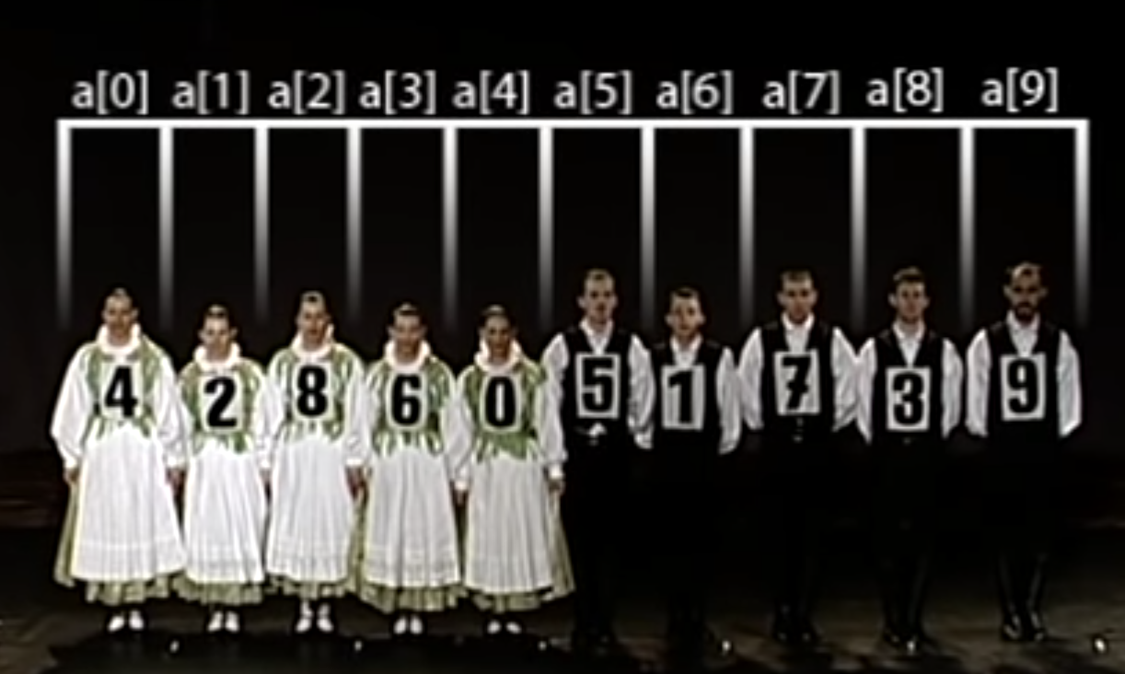
Merge sort O(n log n)
The idea is to split currently active region in half, sorting both the left and right subregions, then merge two sorted subregions
Eventually, the regions are so small we can sort in constant time; i.e., sorting 2 nums is easy
Merging two sorted lists can be done in linear time
https://youtu.be/XaqR3G_NVoo

Slide 14
Algorithm is simple but efficient (nlogn)
def msort(A):
if len(A)==1:
return A
if len(A)==2:
return A if A[0]<A[1] else [A[1],A[0]]
mid = int(len(A)/2)
left = msort(A[:mid])
right = msort(A[mid:])
return sorted(left + right)
“sorted(left + right)” is cheating but used for simplicity here; merging two sorted lists is O(n)
(Note: constant on this is huge)

Slide 15
Exercise: write pow2(n)
Compute 2^n recursively by multiplying 2 together n times
Now do iterative version
def pow2(n):
if n==0: return 1
return 2 * pow2(n-1)
def pow2(n):
v = 1
for i in range(n): v *= 2
return v

Slide 16
Can we do pow2 more efficiently?
Divide and conquer; hint 2^n = 2^(n/2) * 2^(n/2) if n is even If n odd, it’s 2 times 2^floor(n/2)
A non-recursive version would be awkward and hard to write!
def pow2(n):
if n==0: return 1
half = pow2(int(n/2))
if n % 2==0: # if even
return half * half
return 2 * half * half

Slide 17
Recursion summary
Use recursion when implementing a recurrence relation (not always for efficiency reasons, such as gradient descent)
Use recursion when you can break problem down into subproblems whose results can be merged to solve overall problem; divide and conquer
Use recursion when the same operation and navigation procedure applies to any element of a data structure; binary search, walking trees and graphs; self-similar structures
Recursion traces out a function call tree

Slide 18
An Aside: Caching partial results with dynamic programming

Slide 19
Dynamic programming trades memory for speed
We can often can decompose a problem into subproblems and combine the partial results to form the overall result
If the same computation is repeated, it’s a candidate for dynamic programming
Dynamic programming is a terrible, meaningless name that simply means caching or memoizing partial results and using those to avoid redundant computations
Idea: compute “1+1+1+1”. That’s 4. If I append “+1”, what is sum?
You reused the 4 result hopefully; that’s dynamic programming
https://www.geeksforgeeks.org/dynamic-programming

Slide 20
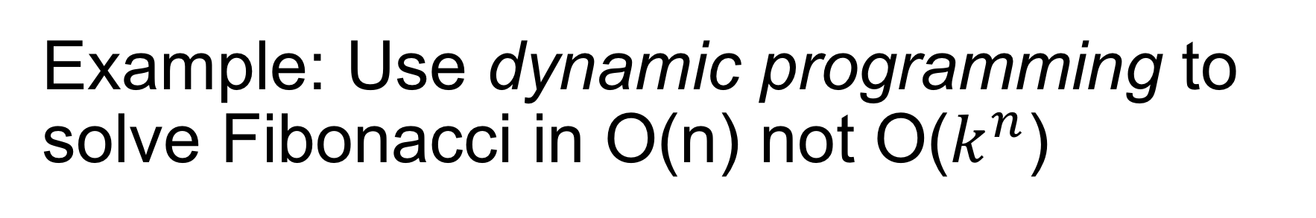
Example: Use dynamic programming to solve Fibonacci in O(n) not O($k^{n}$)
Make cache F of size n, working upwards, fill in F
cachefib(1000) take 0.3s compared to fib(37) at 16.7s (wow)
Algorithmic changes matter much more than code optimizations!!!
def cachefib(n):
F = [0 for i in range(n+1)]
F[0] = F[1] = 1 # init cache
for i in range(2,n+1): # work up not down
F[i] = F[i-1] + F[i-2]
return F[n]

Slide 21
Example: use cache with recursive fib()
The recursive version is more natural; to make efficient record partial results and look in cache before computing anything
memo = {}
def memofib(n):
if n==0 or n==1: return 1
# return if already computed
if n in memo: return memo[n]
f = memofib(n-1) + memofib(n-2)
memo[n] = f # memoize result
return f

Slide 22
Memoized recursive function template
def f(input):
1. check termination condition as usual
2. return memoized result if available
3. process the active input region / current node, etc…
4. invoke f on subregion(s)
5. combine results and memoize
6. return results
Blue regions differ from normal recursive function template

Slide 23
Check out the recursion notebook
https://github.com/parrt/msds689/blob/master/notes/recursion-notebook.ipynb

